Slide 1
Security
Symmetric Encryption and Message Confidentiality
Assistant professor – Faculty of computers and information – Beni Suef University

Slide 2
Brute Force attack
Involves trying every possible key until an intelligible translation of the ciphertext into plaintext is obtained
On average, half of all possible keys must be tried to achieve success
Unless known plaintext is provided, the analyst must be able to recognize plaintext as plaintext
To supplement the brute-force approach
Some degree of knowledge about the expected plaintext is needed
Some means of automatically distinguishing plaintext from garble is also needed
Adapted from William Stalling, Network Security Essentials, Applications and Standards, Fifth Edition
Notes:
Unfortunately, it is very difficult to estimate the amount of effort required
to cryptanalyze ciphertext successfully. However, assuming there are no inherent
mathematical weaknesses in the algorithm, then a brute-force approach is indicated.
A brute-force attack involves trying every possible key until an intelligible
translation of the ciphertext into plaintext is obtained. On average, half of all possible
keys must be tried to achieve success. That is, if there are x different keys, on
average an attacker would discover the actual key after x /2 tries. It is important
to note that there is more to a brute-force attack than simply running through all
possible keys. Unless known plaintext is provided, the analyst must be able to recognize
plaintext as plaintext. If the message is just plaintext in English, then the
result pops out easily, although the task of recognizing English would have to be
automated. If the text message has been compressed before encryption, then recognition
is more difficult. And if the message is some more general type of data,
such as a numerical file, and this has been compressed, the problem becomes even
more difficult to automate. Thus, to supplement the brute-force approach, some
degree of knowledge about the expected plaintext is needed, and some means of
automatically distinguishing plaintext from garble is also needed.

Slide 3
Data Encryption Standard (DES)
Most widely used encryption scheme
Issued in 1977 as Federal Information Processing Standard 46 (FIPS 46) by the National Institute of Standards and Technology (NIST)
The algorithm itself is referred to as the Data Encryption Algorithm (DEA)
Adapted from William Stalling, Network Security Essentials, Applications and Standards, Fifth Edition
Notes:
The most widely used encryption scheme is based on the Data Encryption Standard
(DES) issued in 1977, as Federal Information Processing Standard 46 (FIPS 46) by
the National Bureau of Standards, now known as the National Institute of Standards
and Technology (NIST). The algorithm itself is referred to as the Data Encryption
Algorithm (DEA).

Slide 4
DES algorithm
Description of the algorithm:
Plaintext is 64 bits in length
Key is 56 bits in length
Structure is a minor variation of the Feistel network
There are 16 rounds of processing
Process of decryption is essentially the same as the encryption process
The strength of DES:
Concerns fall into two categories
The algorithm itself
Refers to the possibility that cryptanalysis is possible by exploiting the characteristics of the algorithm
The use of a 56-bit key
Adapted from William Stalling, Network Security Essentials, Applications and Standards, Fifth Edition
Notes:
The plaintext is 64 bits in length and the key is
56 bits in length; longer plaintext amounts are processed in 64-bit blocks. The DES
structure is a minor variation of the Feistel network shown in Figure 2.2. There are
16 rounds of processing. From the original 56-bit key, 16 subkeys are generated, one
of which is used for each round.
The process of decryption with DES is essentially the same as the encryption
process. The rule is as follows: Use the ciphertext as input to the DES algorithm, but
use the subkeys K_{i} in reverse order. That is, use K₁₆ on the first iteration, K₁₅ on the
second iteration, and so on until K₁ is used on the 16th and last iteration.
Concerns about the strength of DES fall into two categories:
concerns about the algorithm itself and concerns about the use of a 56-bit key.
The first concern refers to the possibility that cryptanalysis is possible by exploiting
the characteristics of the DES algorithm. Over the years, there have been numerous
attempts to find and exploit weaknesses in the algorithm, making DES the most studied
encryption algorithm in existence. Despite numerous approaches, no one
has so far succeeded in discovering a fatal weakness in DES.
A more serious concern is key length. With a key length of 56 bits, there are
2⁵⁶ possible keys, which is approximately 7.2 * 10¹⁶ keys. Thus, on the face of it,
a brute-force attack appears impractical. Assuming that on average half the key
space has to be searched, a single machine performing one DES encryption per
microsecond would take more than a thousand years to break the cipher.
However, the assumption of one encryption per microsecond is overly
conservative. DES finally and definitively proved insecure in July 1998, when the
Electronic Frontier Foundation (EFF) announced that it had broken a DES encryption
using a special-purpose “DES cracker” machine that was built for less than
$250,000. The attack took less than three days. The EFF has published a detailed
description of the machine, enabling others to build their own cracker [EFF98].
And, of course, hardware prices will continue to drop as speeds increase, making
DES virtually worthless.
With current technology, it is not even necessary to use special, purpose-built
hardware. Rather, the speed of commercial, off-the-shelf processors threaten the
security of DES. A paper from Seagate Technology [SEAG08] suggests that a rate
of one billion (10⁹ ) key combinations per second is reasonable for today’s multicore
computers. Recent offerings confirm this. Both Intel and AMD now offer hardware based
instructions to accelerate the use of AES. Tests run on a contemporary multicore
Intel machine resulted in an encryption rate of about half a billion [BASU12].
Another recent analysis suggests that with contemporary supercomputer technology,
a rate of 10¹³ encryptions/s is reasonable [AROR12].

Slide 5
Simplified DES
Encryption
Takes an 8-bit block of plaintext and a 10-bit key as input and produces an 8-bit of cipher.
Decryption
Takes an 8-bit block of cipher and the same 10-bit key as input and produces an 8-bit of original plaintext.
Both substitution and transposition operations are used
It is a complex, multi-phase algorithm

Slide 6
Five Functions of Simplified DES
IP: Initial permutation
f_{k:} Key-dependent function
Use a 8-bit key
Perform both permutation and substitution
SW ( simple permutation function)
Swap the two halves of data
f_{k} again (different key)
IP⁻¹: Inverse permutation

Slide 7
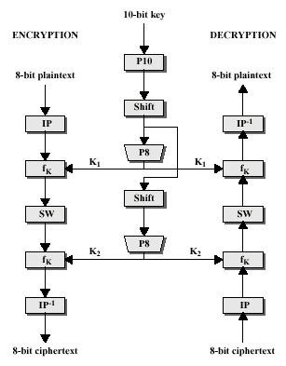
S-DES Block Diagram

Slide 8
S-DES Algorithm
We can concisely express the encryption algorithm as a composition of function: IP⁻¹ ° fk2° SW ° fk1° IP OR AS:
Cipher = IP⁻¹(f_{k2}(SW(f_{k1}(IP(plaintext)))))
K₁ = P8(Shift(P10(key)))
K₂ = P8(Shift(Shift(P10(key))))
Plaintext = IP⁻¹(f_{k1}(SW(f_{k2}(IP(ciphertext)))))

Slide 9
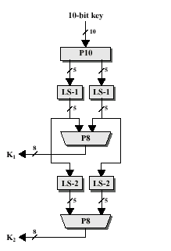
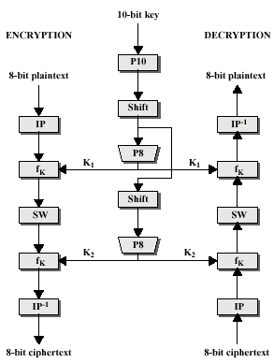
Key Generation
S-DES Block Diagram
S-DES Key Generation Block Diagram

Slide 10
Key Generation
10-Bit Key: Make up by sender
P10: Permutation 10 (Constant)
P8: Permutation 8 (Constant)

Slide 11
Example of Key Generation

Slide 12
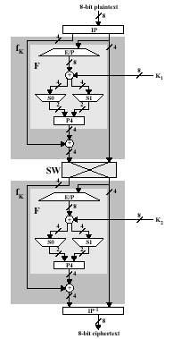
S-DES Encryption Functions Block Diagram

Slide 13
Encryption
8-Bit Plaintext: Make up by sender
IP: Initial Permutation (constant)
IP⁻¹: Inversed Permutation (constant)

Slide 14
Encryption
E/P: Expansion/Permutation Rule (constant)
P4: Permutation 4 (constant)
S0 Box (constant)
S1 Box (constant)

Slide 15
Example of Encryption

Slide 16
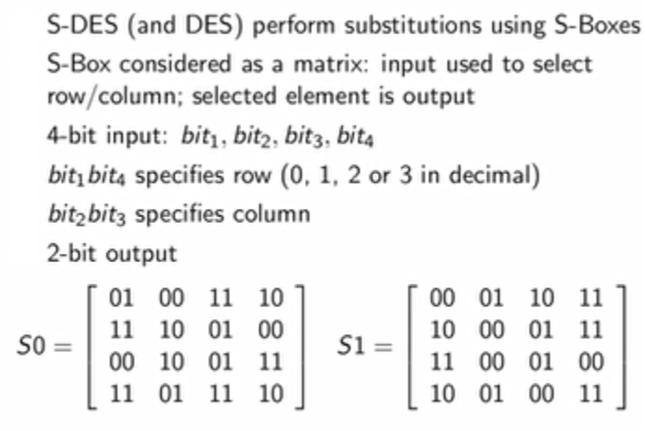
S-boxes

Slide 17
Example of Encryption

Slide 18
Example of Encryption

Slide 19
Example of Encryption

Slide 20
Fk again

Slide 21
Fk again

Slide 22
Fk again

Slide 23
The End

